Slide 1
CS F372 Operating Systems
08 - Process Synchronization Introduction

Slide 2
Text Book Reading
Chapter 5. Sections 5.1 and 5.2

Slide 3
Introduction
Independent processes
That cannot affect or be affected by other processes executing in the system
Do not share data
Cooperating processes
That can affect or be affected by other processes executing in the system
Share code & data either directly or through files
Orderly execution of cooperating processes that share a logical address space

Slide 4
Concurrent or parallel execution - Issues
Concurrent execution
Consider TSS, where the CPU scheduler switches rapidly between processes
One process may only partially complete execution before another process is scheduled
Parallel execution
Processes can execute simultaneously on separate processing cores
Problem
Data integrity
Maintaining data consistency requires mechanisms to ensure the orderly execution of cooperating processes

Slide 5
Example: Data Integrity Issue
Producer consumer (Bounded buffer) problem
Producer – produces information
Consumer – consumes information
Shared space/memory is Buffer
Buffer – implemented as a circular array
in points to the next position in the buffer where an item can be placed
out points to the position in the buffer from where the next item can be consumed
Counter initialized to 0. incremented every time we add a new item to the buffer and is decremented every time we remove one item from the buffer

Slide 6
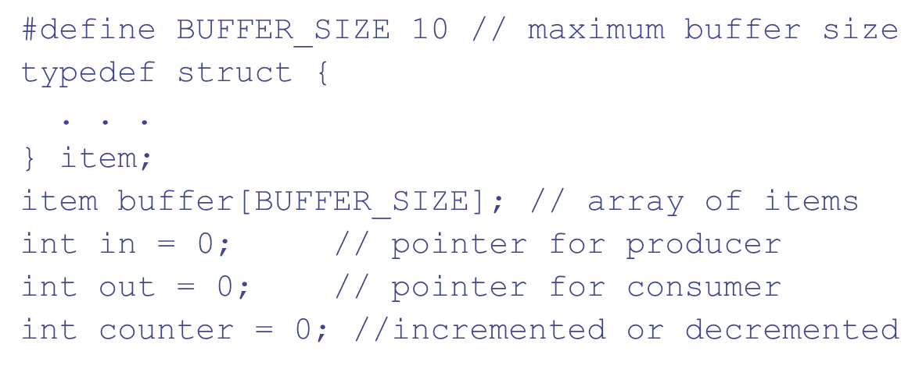
Bounded buffer

Slide 7
Bounded buffer
Producer process
/* produce an item in next_Produced */
item next_Produced; //local variable
while (1) {
while (counter == BUFFER_SIZE);
/* do nothing */
buffer[in] = next_Produced;
in = (in + 1) % BUFFER_SIZE;
counter++;
}

Slide 8
Bounded buffer
Consumer process
item nextConsumed;
while (1) {
while (counter == 0);
/* do nothing */
next_Consumed = buffer[out];
out = (out + 1) % BUFFER_SIZE;
counter--;
/* consume the item in next_Consumed */
}

Slide 9
Bounded buffer
The statement “counter++” may be implemented in assembly language as:
register1 = counter
register1 = register1 + 1 counter = register1
The statement “counter--” may be implemented as:
register2 = counter register2 = register2 – 1 counter = register2

Slide 10
Bounded buffer
If both the producer and consumer attempt to update the buffer concurrently, the assembly language statements may get interleaved.
Interleaving depends upon how the producer and consumer processes are scheduled.

Slide 11
Bounded Buffer
Assume counter is initially 5.
One interleaving of statements is:
producer: register1 = counter (register1 = 5) producer: register1 = register1 + 1 (register1 = 6) consumer: register2 = counter (register2 = 5) consumer: register2 = register2 – 1 (register2 = 4) producer: counter = register1 (counter = 6) consumer: counter = register2 (counter = 4)
The value of counter may be either 4 or 6, where the correct result should be 5.

Slide 12
Race Condition
Race condition: The situation where several processes access and manipulate shared data concurrently. The final value of the shared data depends upon order in which the access takes place!
To prevent race conditions, concurrent processes must be synchronized

Slide 13
The Critical-Section Problem
n processes all competing to use some shared data
Each process has a code segment, called critical section, in which the shared data is accessed.
Necessary feature – ensure that when one process is executing in its critical section, no other process is allowed to execute in its critical section
The critical-section problem is to design a protocol that the processes can use to cooperate

Slide 14
Structure of a process
General structure of process P_{i}
do {
entry section
critical section
exit section
remainder section
} while (1);

Slide 15
Structure of a process
Each process must request permission to enter its critical section. The section of code implementing this request is the entry section
The critical section may be followed by an exit section.
The remaining code is the remainder section.

Slide 16
Solution to Critical-Section Problem - Requirements
Mutual Exclusion. If process P_{i} is executing in its critical section, then no other processes can be executing in their critical sections.
Progress. If no process is executing in its critical section and there exist some processes that wish to enter their critical section, then only those processes that are not executing in their remainder sections can participate in deciding which will enter its critical section next, and this selection cannot be postponed indefinitely.

Slide 17
Solution to Critical-Section Problem
Bounded Waiting. A bound must exist on the number of times that other processes are allowed to enter their critical sections after a process has made a request to enter its critical section and before that request is granted.

